Slide 1
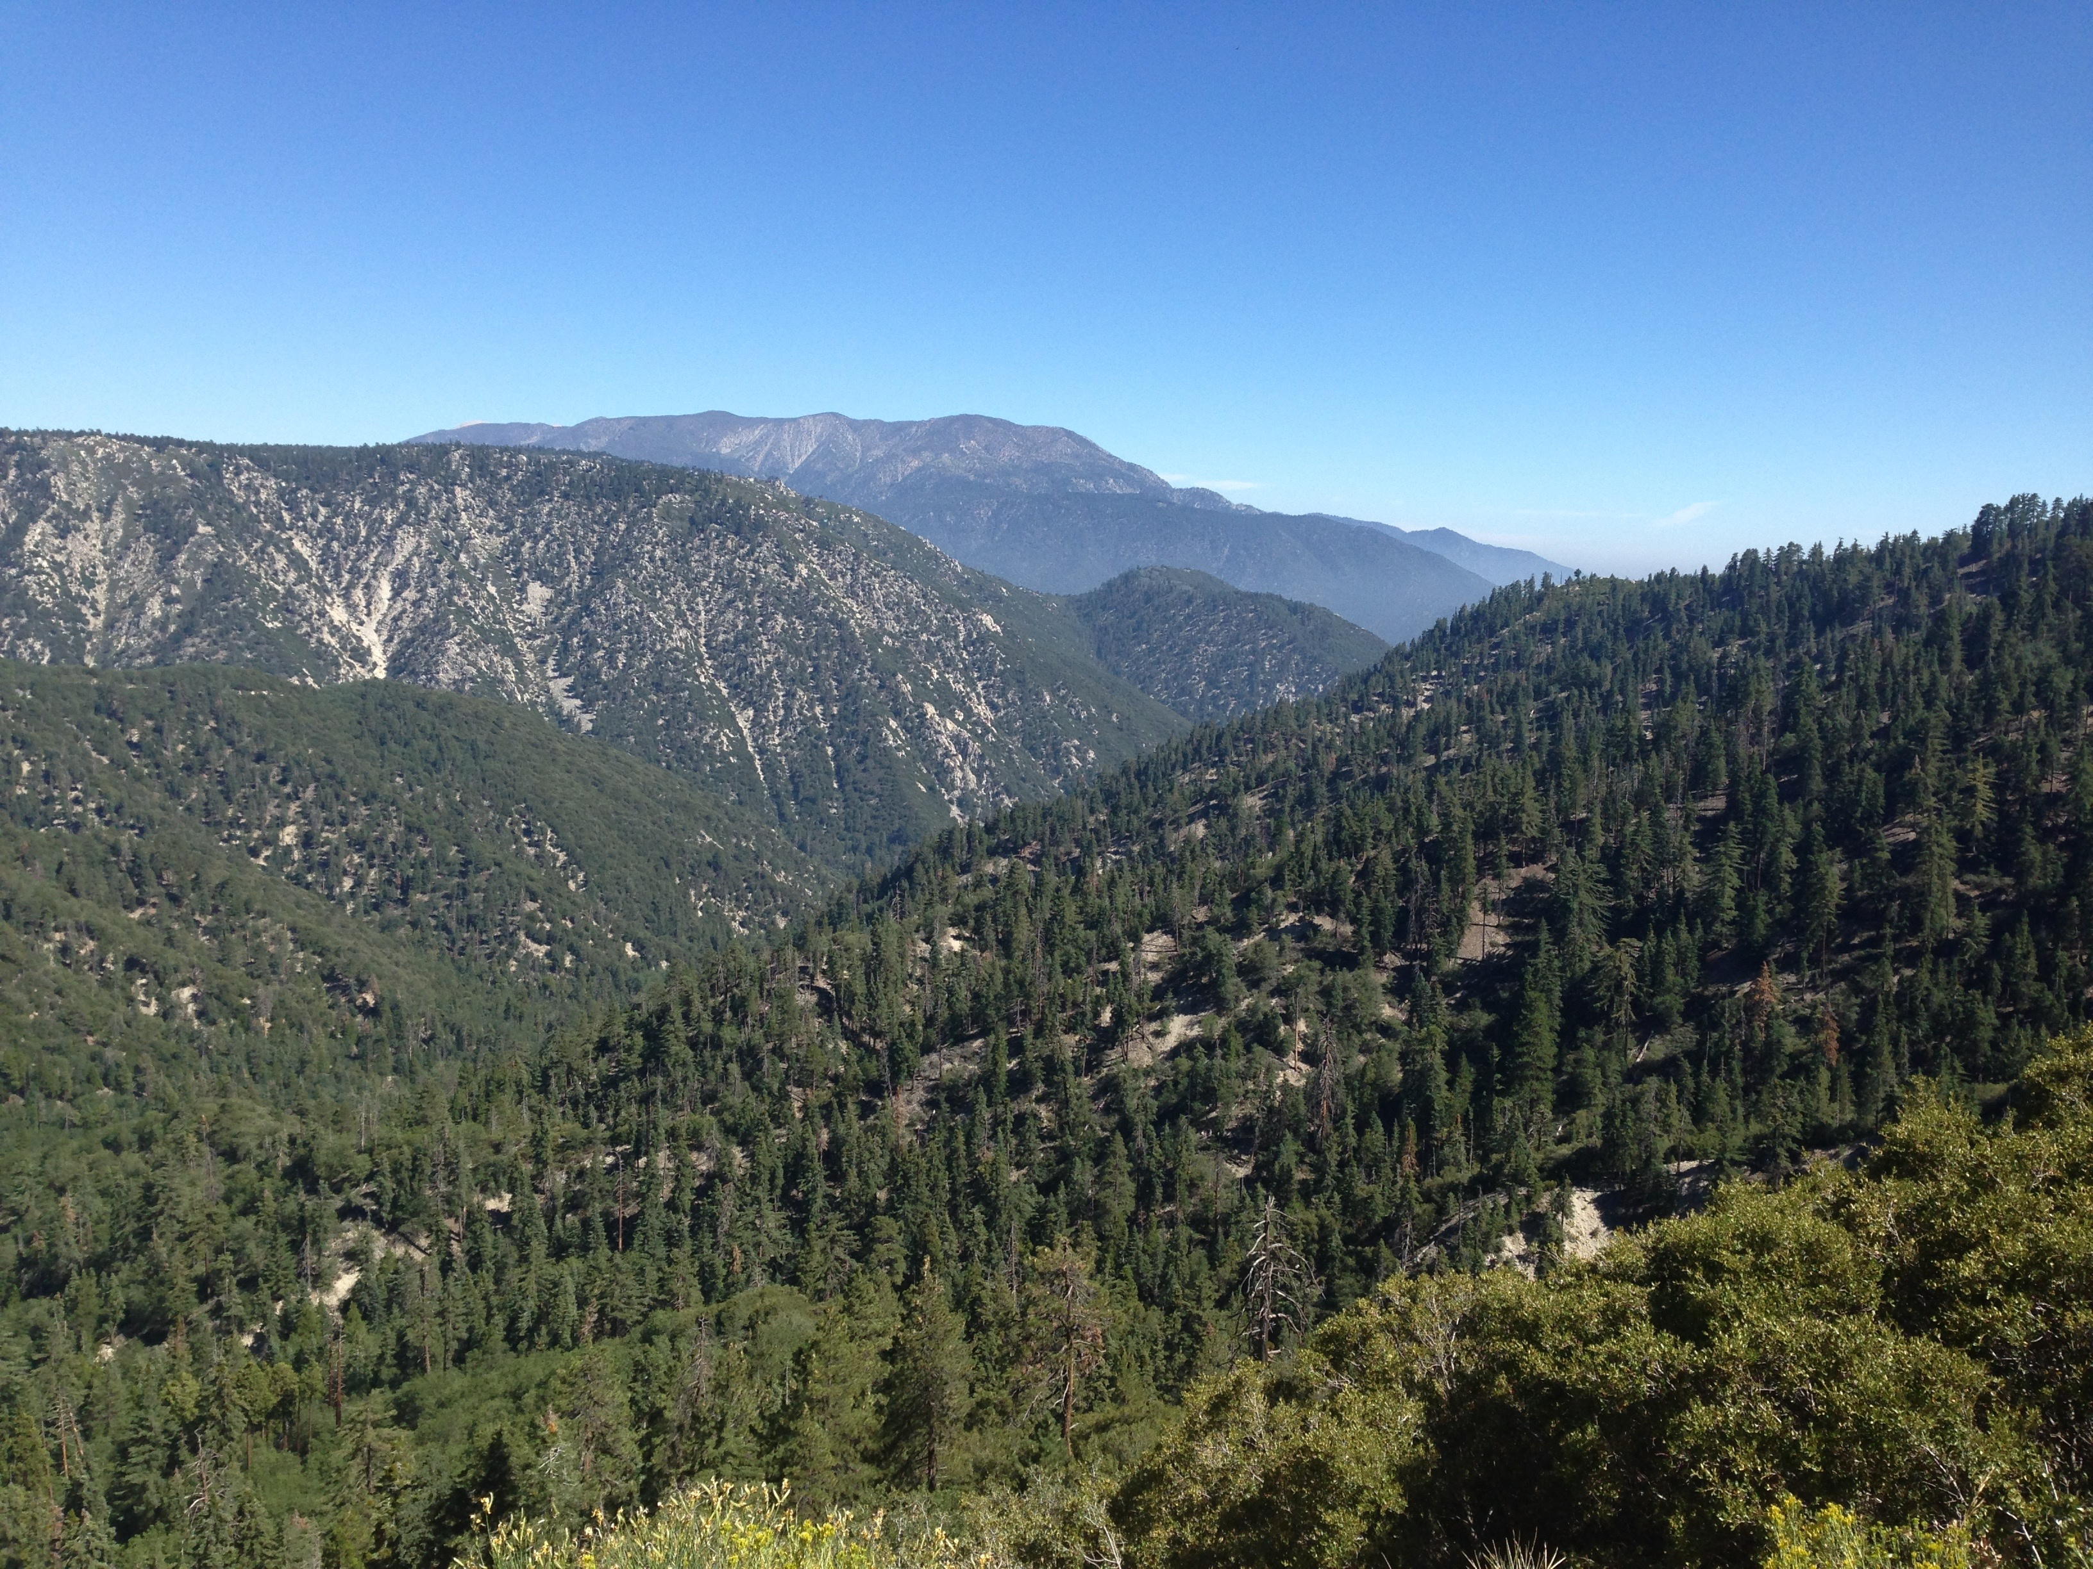
Geomorphic evolution in active landscapes
Katherine Boot
Mentor: Dr. Arjun Heimsath
School of Earth and Space Exploration, ASU

Slide 2
Introduction
Erosion mitigation is a considerable research focus in upland agricultural regions.
Objective: Map exposed bedrock where the production and erosion rate are near to maximum in the San Bernardino Mountains
(Amen 2016)
(Natural Resources Conservation Service)

Slide 3
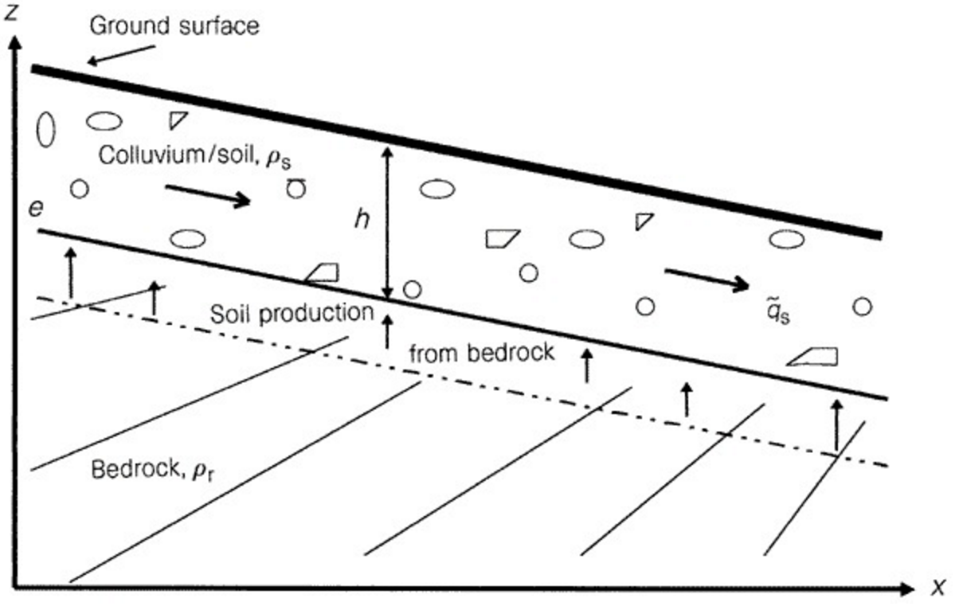
Soil Production Processes
Figure 1 - “The soil production function and landscape equilibrium.” Heimsath et. al. (1997).

Slide 4
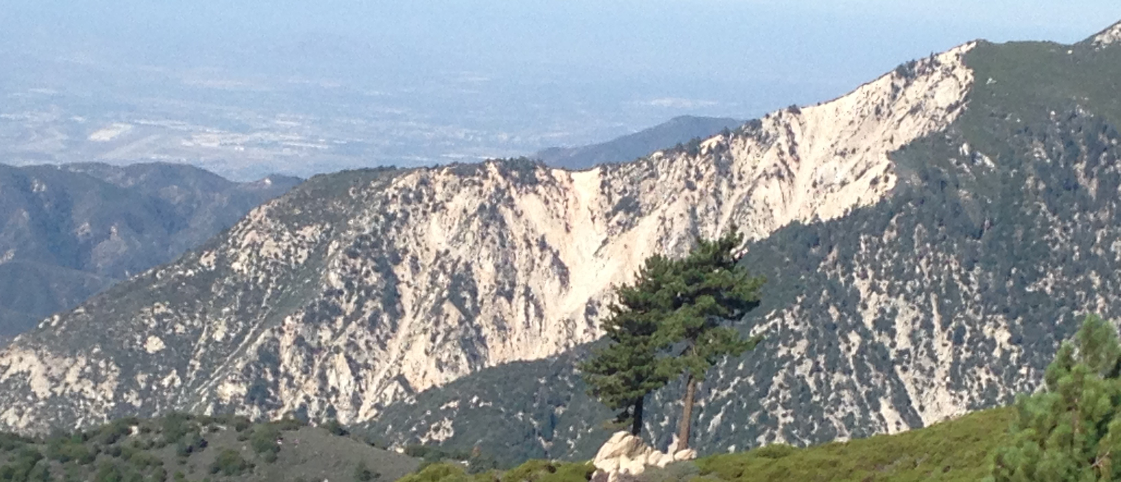
Soil Erosion Processes
Soil Creep
  bioturbation
  freeze-thaw
  shrink-swell
Threshold topography - hillslope is defined by bedrock landsliding and bedrock strength rather than steady soil creep.
Exposed bedrock - indicates that local erosion rates exceed production rates.
Stochastic
  landslides
  bedrock strength
  slope failure

Slide 5
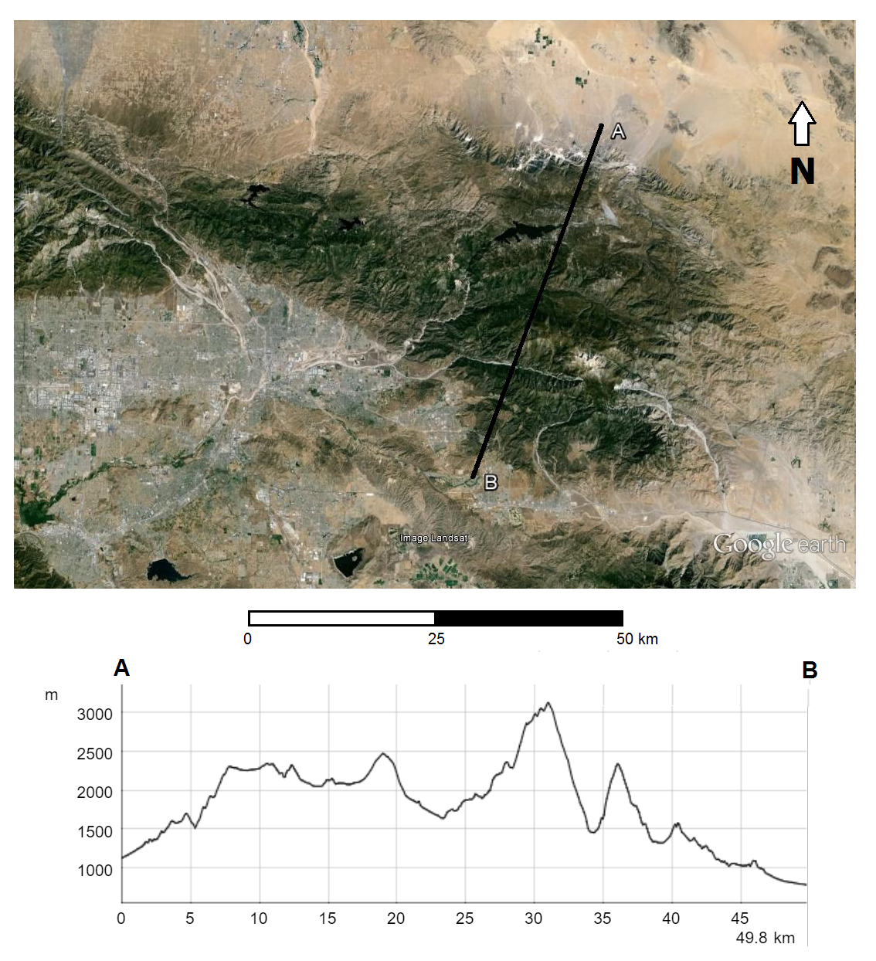
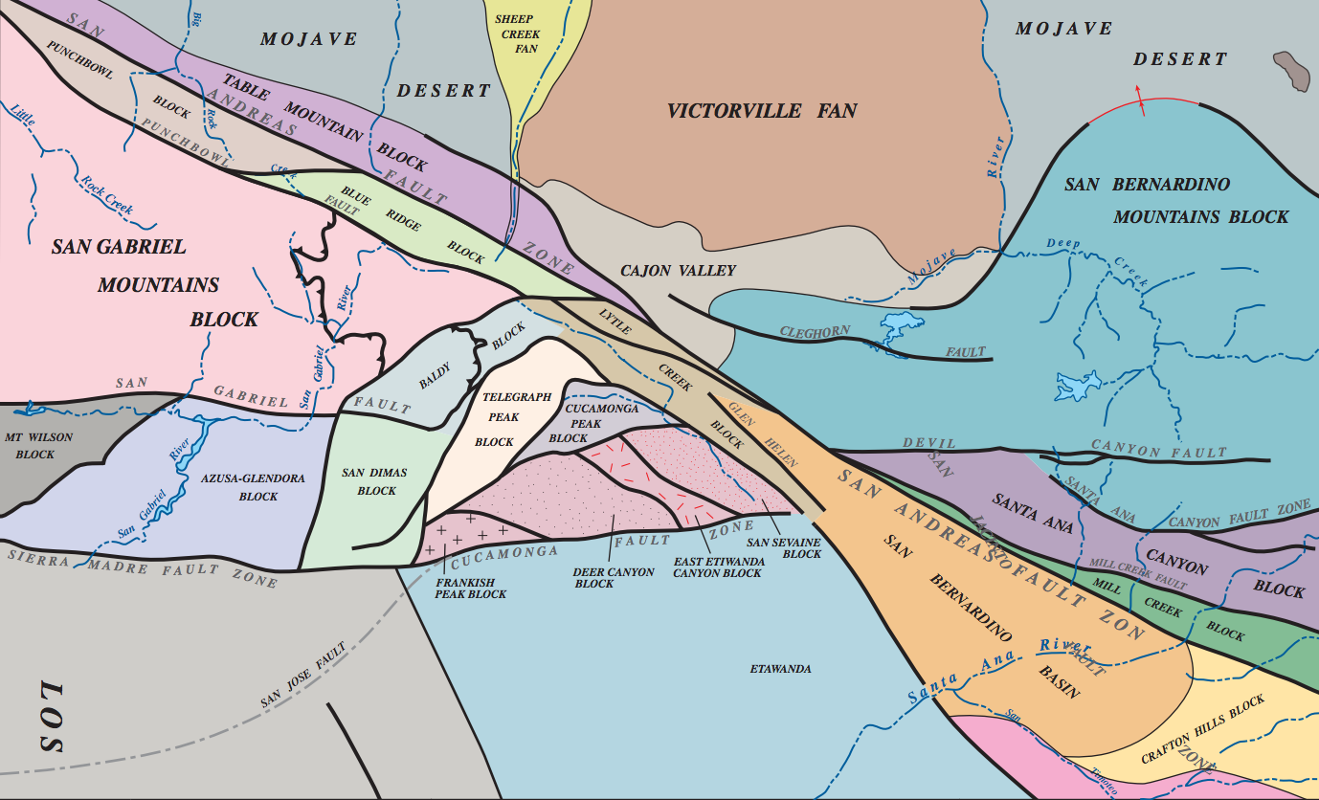
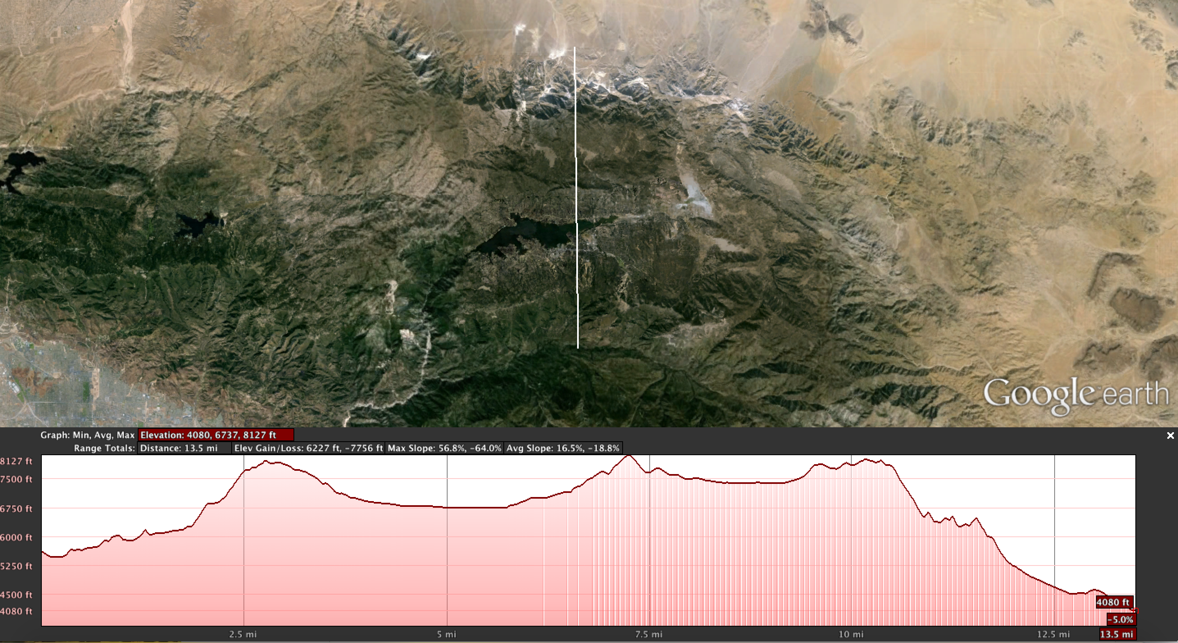
San Bernardino Mountains
Actively uplifting fault zone
South blocks– high relief
North blocks– low relief
threshold topography
  local base level drop
  hillslope steepening
  adapting channel systems
Figure 2 – Map of definable structural blocks. (Morton et al. 2006)
Figure 3 (Google Earth, 2016)

Slide 6
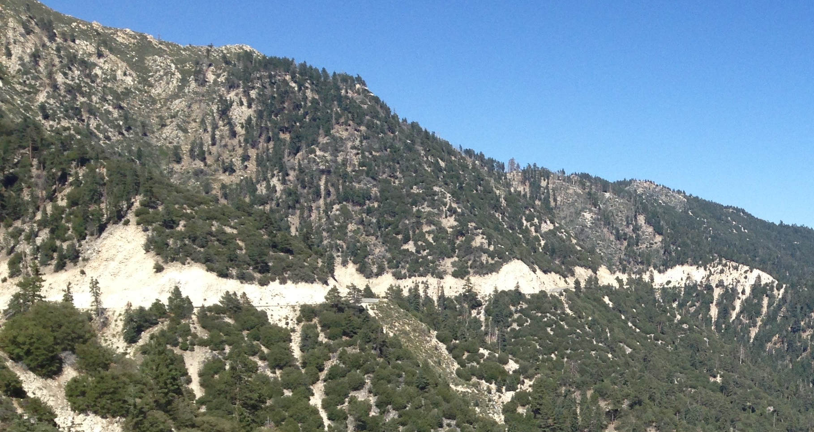
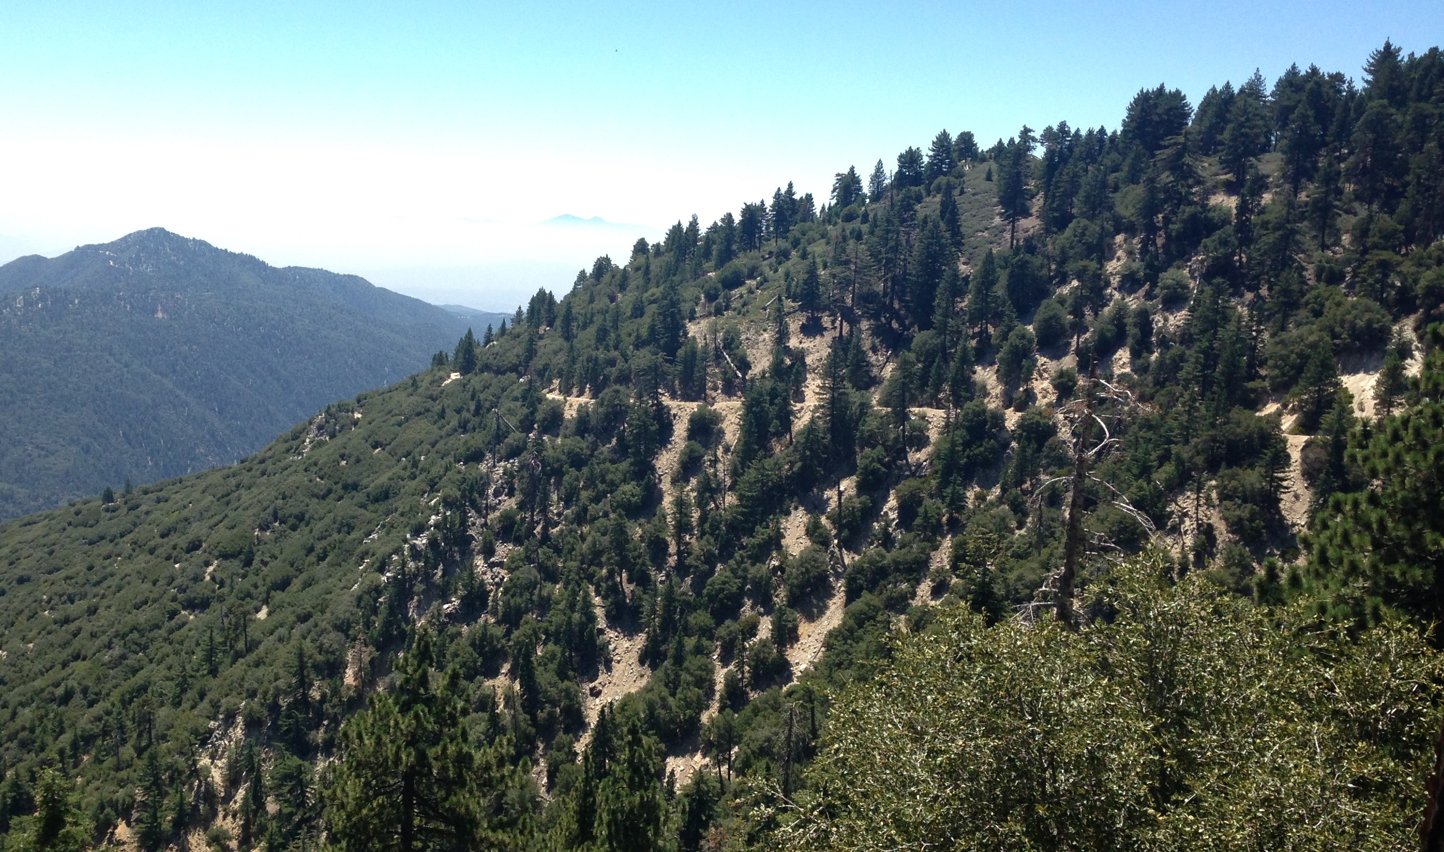
Exposed Bedrock
transition from steady-state to stochastic erosional processes
Physical characteristics
  Blocky, fractured masses
  Vertical cliff faces
  Hill slope/gradient
  Vegetation cover

Slide 7
Research Goals
Objective – Map exposed bedrock where the production and erosion rate are near to maximum in the San Bernardino Mountains.
Cosmogenic radionuclide dating (¹⁰Be )
Field measurements - soil thickness, saprolite/regolith, weathering formations
Research from similar localities
Figure 5 (W&M Department of Geology, 2011)

Slide 8
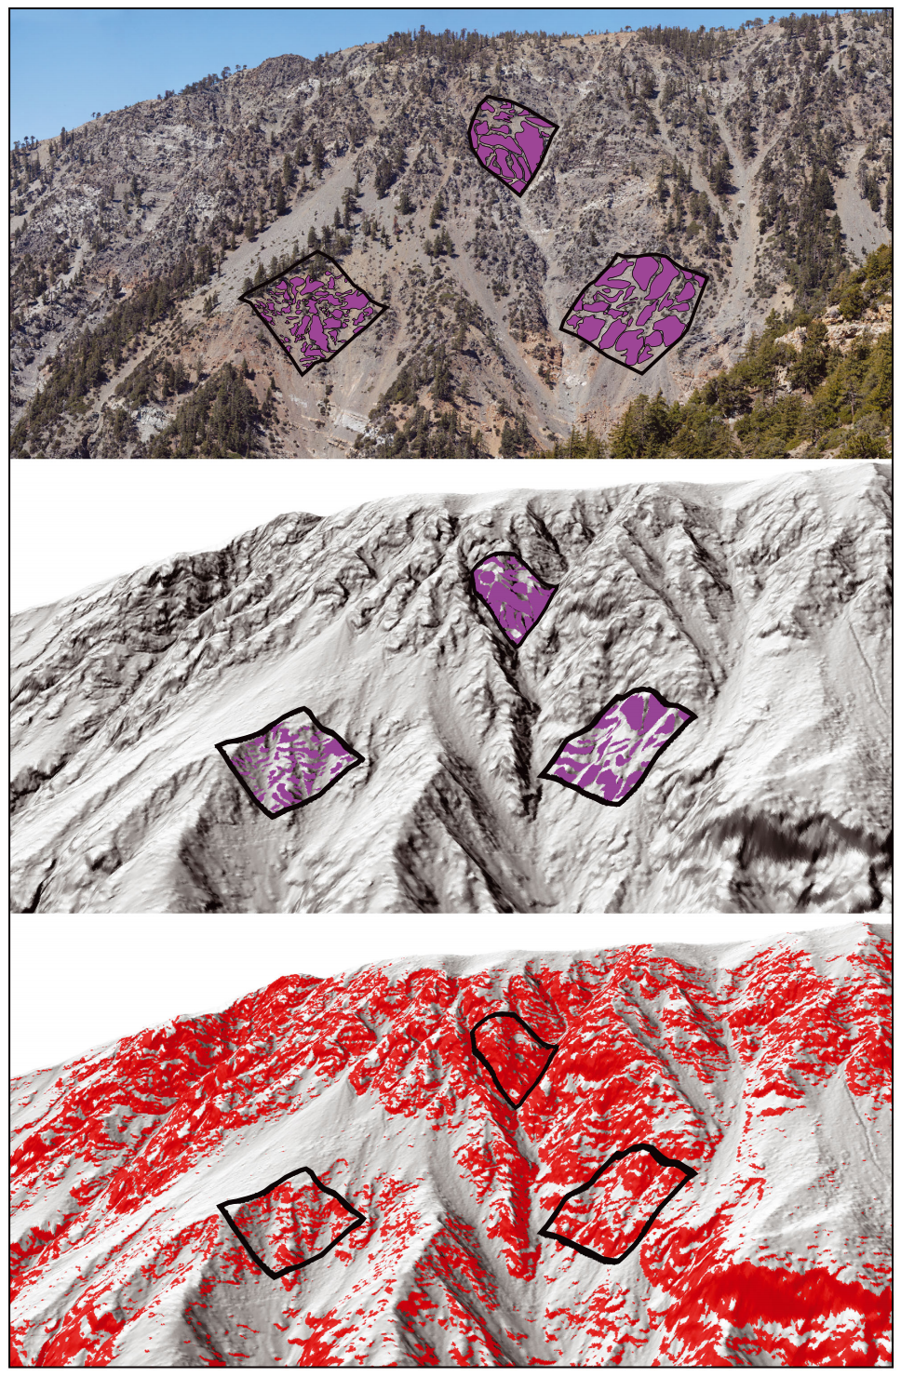
Conclusion
Quantify human and environmental effects on soil production
encourage sustainable development in agriculture, resource management, etc.
minimize human impact on soil condition
predict the evolution of landscape erosion
Figure 4 (DiBiase et al. 2012)

Slide 9
Works Cited
34°16'6.19"N, 116°53'19.20 »W. Google Earth. April 9, 2013. January 26, 2016
Amen, Hal. "30 Spectacular Examples of Terraced Agriculture [PICs]."Matador Network. N.p., 4 Sept. 2012. Web. 05 Apr. 2016.
DiBiase, Roman A., Arjun M. Heimsath, and Kelin X. Whipple. “Hillslope response to tectonic forcing in threshold landscapes.” Earth Surface Processes and Landforms 37.8. (2012): 855 – 865.
Heimsath, Arjun M., William E. Dietrich, Kunihiko Nishiizume, and Robert C. Finkel. “The soil production function and landscape equilibrium.” Nature, v. 388. (1997):358 – 361.
Morton, Douglas M., Fred K. Miller, Pamela M. Cossette, Kelly R. Bovard. “Geologic Map of the San Bernardino and Santa Ana 30' x 60' quadrangles, California.” USGS. (Dec. 17, 2006): http://pubs.usgs.gov/of/2006/1217/of2006-1217_map/of2006-1217_fig3.pdf
Natural Resources Conservation Service. ”80 Years Helping People Help the Land: A Brief History of NRCS”. USDA, n.d. Web. 05 Apr. 2016.
"Piedmont Saprolite.” The Geology of Virginia. W&M Department of Geology, 2011. Web. 05 Apr. 2016.

